Slide 1

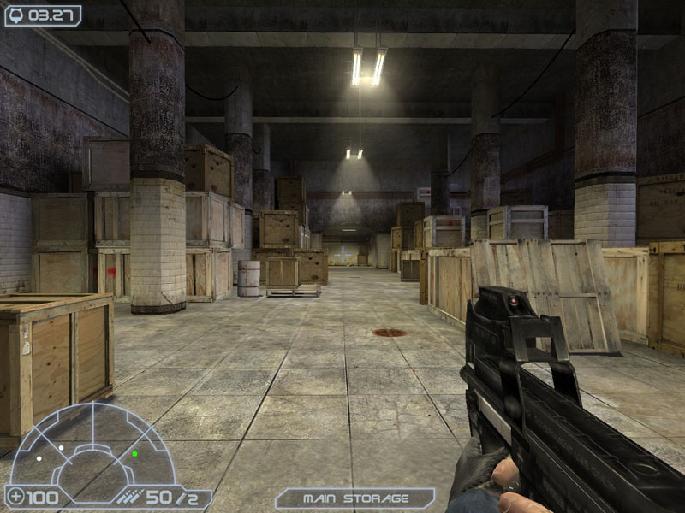
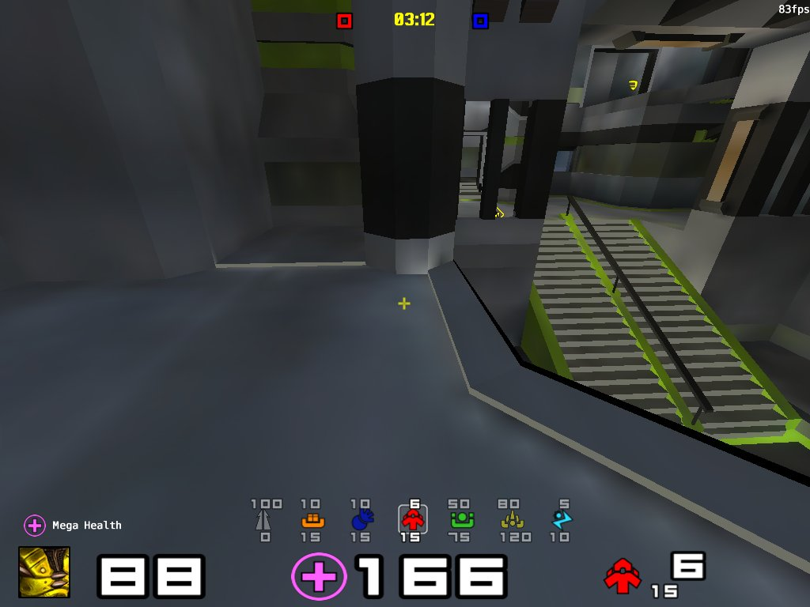
HUD v2
What is HUD?
Head-up Display
Gives player information, such as speed, energy etc.
Transparent to not obstructing the user's view

Slide 2
HUD v2
What is NEW?
Object Oriented Programming instead of Scripting
Three Levels: Element, Panel, Overlay
More flexible and more comfortable to design the HUD

Slide 3

HUD v2
CLASS Bar
Generalized Bar Object
Able to choose length, width, color dynamically
advanced CLASS: SmartBar

Slide 4
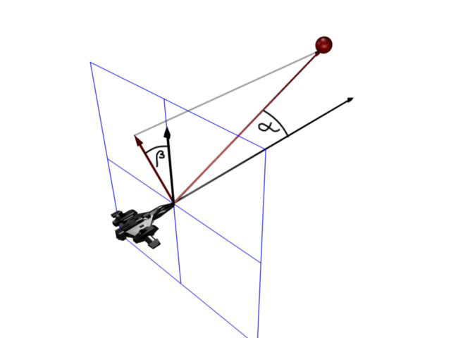
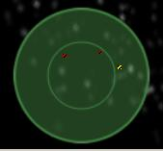
HUD v2
CLASS Radar
Shows where your enemies are
Special concept of radar system

